Slide 1
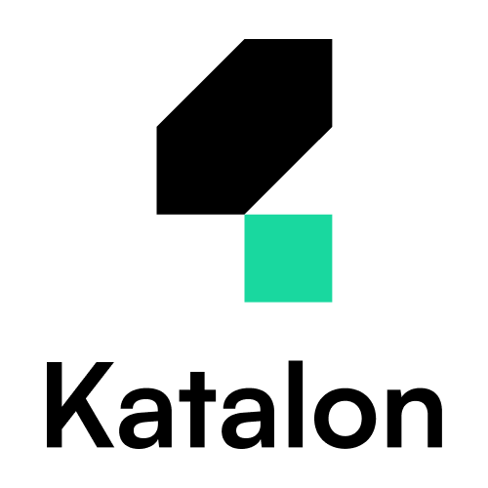
Katalon – Test Automation Platform

Slide 2
All-in-one test automation suite
Execute, Monitor and Evaluate test cases for almost all software products
Easily run multiple test cases in one go using a predefined script containing different data
Re-run these test cases seamlessly whenever new code changes are implemented

Slide 3
Founded in 2016, Katalon is the leading provider of a modern, comprehensive quality management platform
Serving more than 30,000 teams of all shapes & sizes, many of which are in the Fortune Global 500, such as PwC, KMPG, Abbott, and Standard Chartered.
📍 headquartered in Atlanta, GA

Slide 4






Hassle-free Deployment
Quick & Easy Set Up
Flexible Modes
Multi-OS-Application
Better & Faster Results

Slide 5

Hassle-free Deployment
RPA unified packaged platform
Components include
Studio
Runtime engine
Orchestrator(Cloud and On-prem)

Slide 6
Hassle-free Deployment
Quick & Easy Set Up
Flexible Modes
Multi-OS-Application
Better & Faster Results

Slide 7
Quick & Easy Set Up
Katalon offers a low learning curve experience because of its low code approach and pre-built templates and keywords which facilitate starting any script
Plugins and extensions can be easily integrated within studio making it more capable of handling even more complex test cases that traditional low code applications fail to cover
Its packaged runtime engine makes it easily deployable over multiple machines

Slide 8
Hassle-free Deployment
Quick & Easy Set Up
Flexible Modes
Multi-OS-Application
Better & Faster Results

Slide 9
Flexible Modes
Flexibility is a main characteristic that highlights the usability of Katalon and sets it aside as a leader between other test automation suite platforms. Since its offers both lowcode and traditional scripting modes when designing test cases
Test Cases can be either executed as standalone or combined to form test suites. Using test suites, you can either run tests in sequential or parallel modes.
In addition, toggling between different browsers is seamless when testing a web app across multiple browsers

Slide 10
Hassle-free Deployment
Quick & Easy Set Up
Flexible Modes
Multi-OS-Application and Scalability
Better & Faster Results

Slide 11
Multi-OS-Application and Scalability
Katalon Studio can be installed on Windows, Mac OS, and Linux after meeting the required specifications.
The runtime engine offers the ability to deploy your built packages using studio over multiple machines to simulate heavy traffic and parallel executions. Moreover the runtime environment is also available on multiple OSs similar to the Studio.

Slide 12
Hassle-free Deployment
Quick & Easy Set Up
Flexible Modes
Multi-OS-Application
Better & Faster Results

Slide 13
Better & Faster Results
Using TestOps The QA representative can monitor different tests within different projects and organizations
Detailed insights are available with necessary logs to pinpoint any defects or errors within testcases
DEMO

Slide 14
Hassle-free Deployment
Quick & Easy Set Up
Flexible Modes
Multi-OS-Application
Better & Faster Results

